Slide 1
Featured Presentation
Arash Shahsavarani, Environment and Climate Change Canada

Slide 2
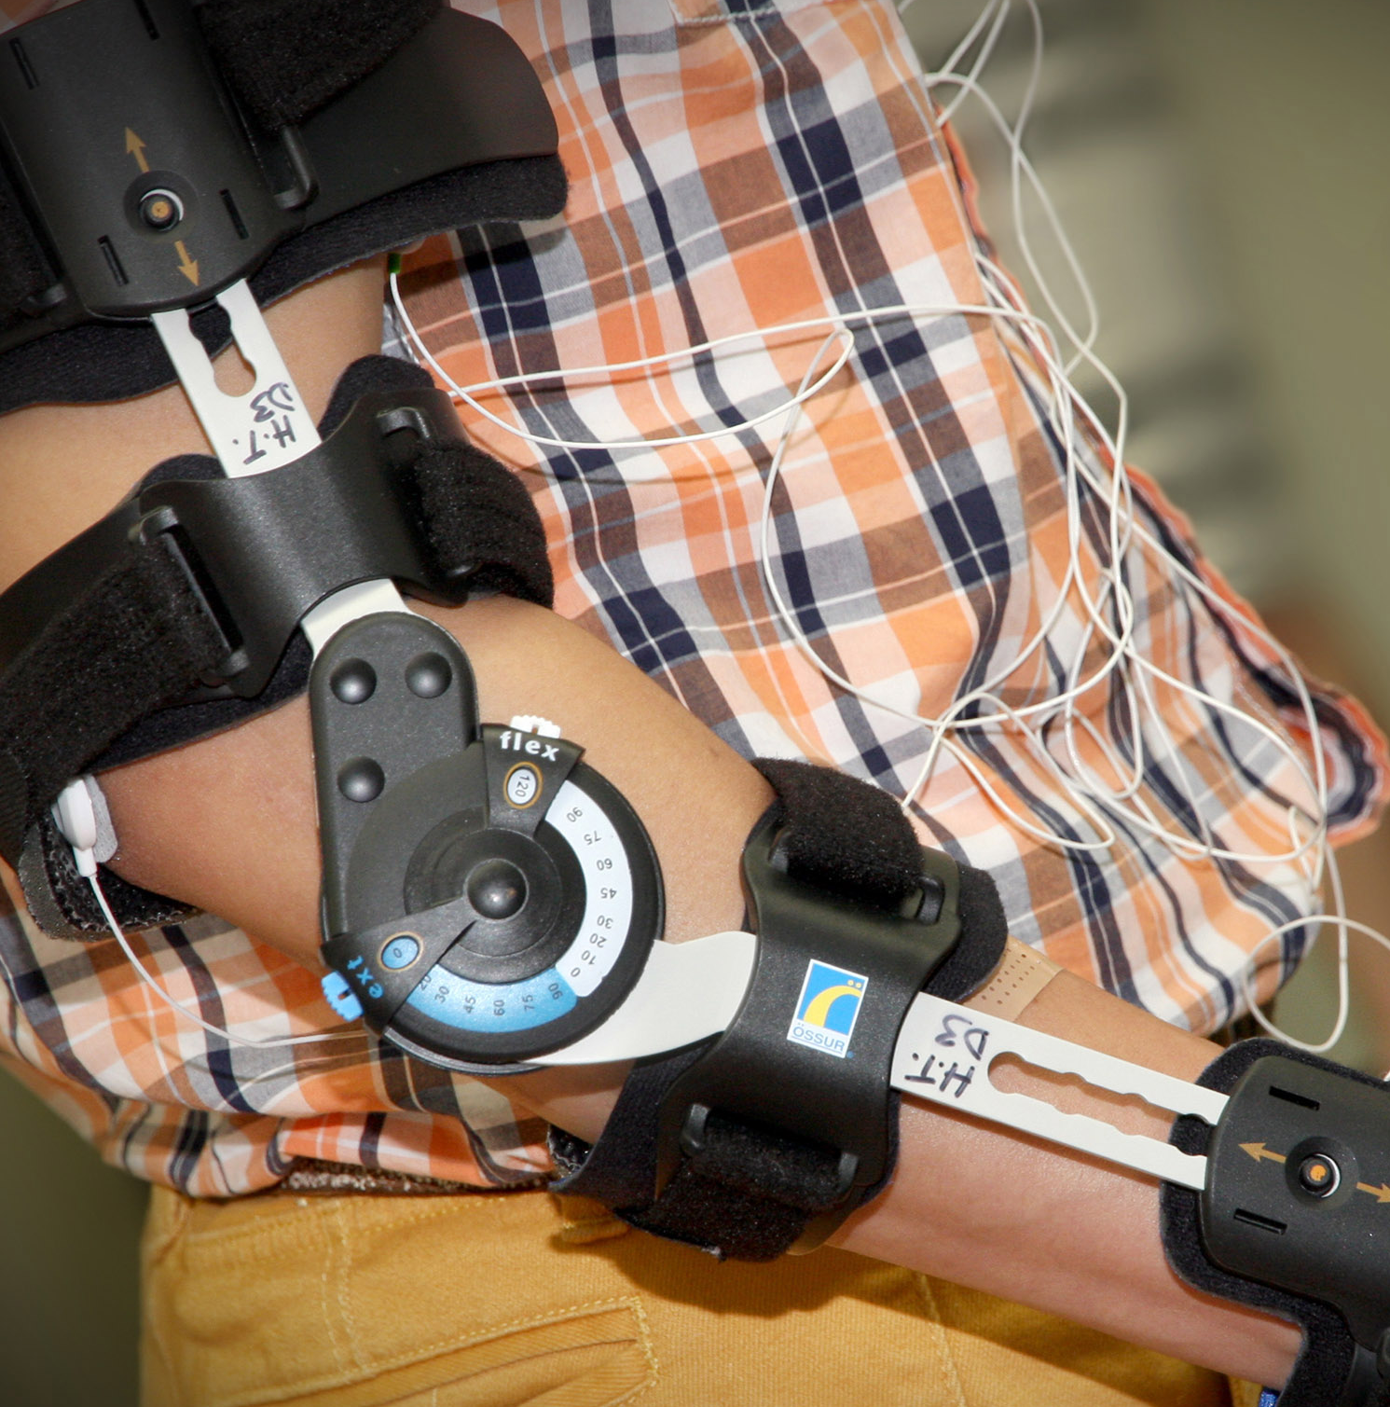
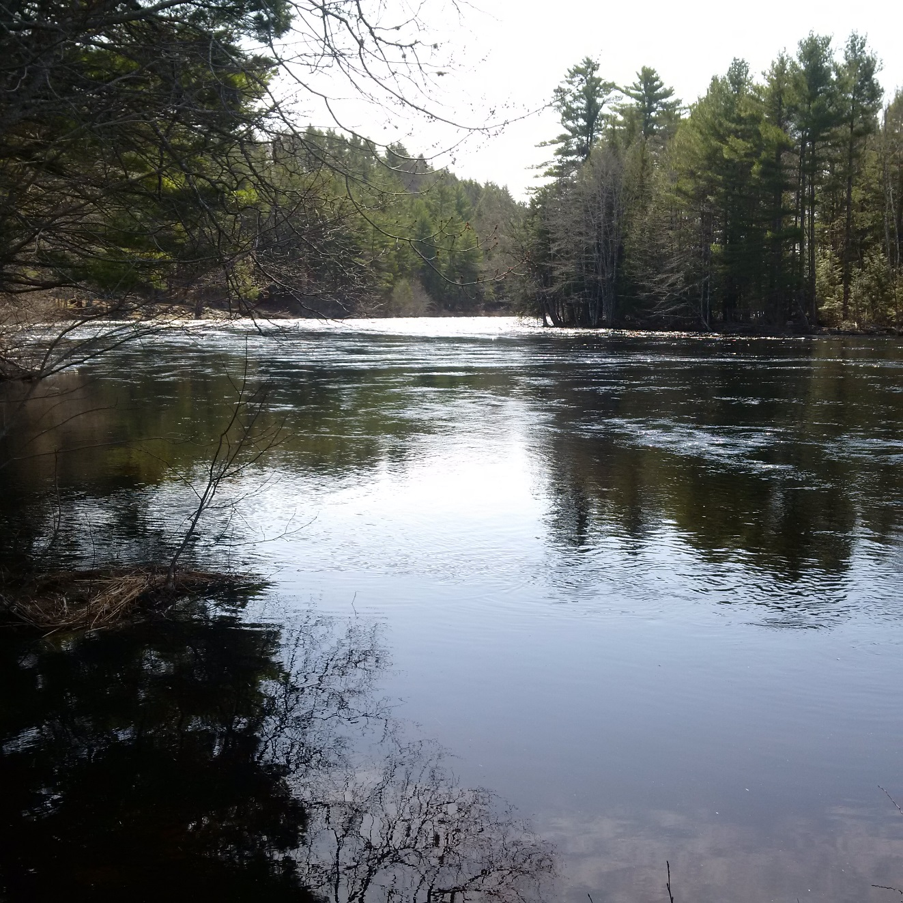
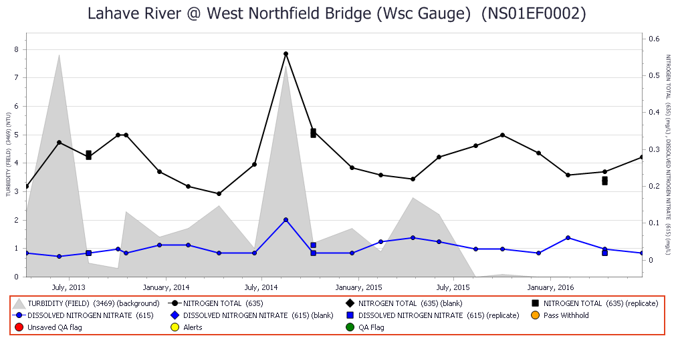
Federal Water Quality Data and DataStream
Water Quality Monitoring and Surveillance Division
Wearable technology, developed with funding
from the NSERC Discovery Grants program
Source: Western University
LaHave River, NS
Arash Shahsavarani and Denis Parent

Slide 3
Outline
Who we are – Water Quality Monitoring and Surveillance Division
Open Government and Open Data
Water Quality Datasets on Open Data
Funding Support
Past collaboration with Community-based Monitoring
Collaboration with Mackenzie and Atlantic DataStreams

Slide 4
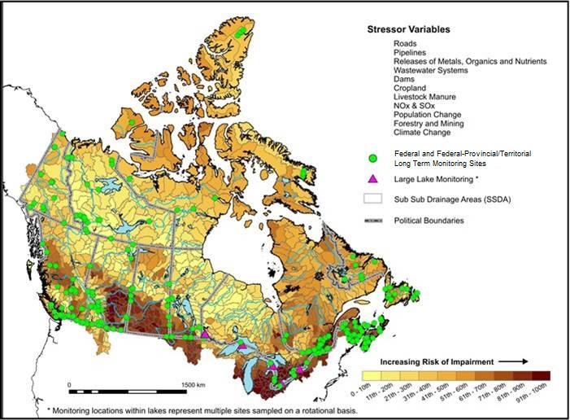
Water Quality Monitoring and Surveillance Division
Status and Trends Monitoring
Physical/Chemical/Biological monitoring using a risk-based adaptive management framework
Issue-based Surveillance
Focused, short term studies targeted on specific threats (Chemical Management Plan, Climate Change Action Plan)
Reporting and Open Data
National watershed and issue based reporting (environmental indicators, web, journals, reports) and provision of monitoring data to the public
Advice
Provide water quality expertise/advice in support of public policy issues and solutions

Slide 5
Directive on Open Government
Objective:
to maximize the release of government information and data of business value to support transparency, accountability, citizen engagement, and socio-economic benefits through reuse, subject to applicable restrictions associated with privacy, confidentiality, and security
Expected Results:
allow Canadians to find and use Government of Canada information and data to support accountability, to facilitate value-added analysis, to drive socio-economic benefits through reuse, and to support meaningful engagement with their government.

Slide 6
Open Government Commitments 2016-2018 Action Plan
Commitment 3: Expand and Improve Open Data
Adopt the International Open Data Charter and initiate implementation of the Charter requirements:
Encourage civil society and private sector organizations to open up their own data where this would be of public benefit;
Commitment 14: Increase Openness of Federal Science Activities (Open Science)
The Government of Canada will take appropriate steps to make the science performed in support of Government of Canada programs and decision-making open and transparent to Canadians.
Commitment 16: Align Open Data Across Canada (Open Data Canada)
The Government of Canada will expand collaboration with provincial, territorial, and municipal partners on further standardizing and harmonizing the delivery of open government data across jurisdictions.

Slide 7
Open Data – Definition (opendefinition.org/od/2.1)
Availability and Access:
the data must be available as a whole and at no more than a reasonable reproduction cost, preferably by downloading over the internet. The data must also be available in a convenient and modifiable form.
Re-use and Redistribution:
the data must be provided under terms that permit re-use and redistribution including the intermixing with other datasets.
Universal Participation:
everyone must be able to use, re-use and redistribute. There should be no discrimination against fields of endeavour or against persons or groups. For example, 'non-commercial' restrictions that would prevent 'commercial' use, or restrictions of use for certain purposes (e.g. only in education), are not allowed.

Slide 8
Benefits of Open Data
Support for innovation
Advancing the government's accountability
Leveraging public sector information to develop consumer and commercial products
Better use of existing investment in community information infrastructure
Support for research
Support informed decisions
Proactive disclosure

Slide 9
Government of Canada Open Data and Open Maps Portals
https://open.canada.ca/en/open-data
https://open.canada.ca/en/open-maps

Slide 10
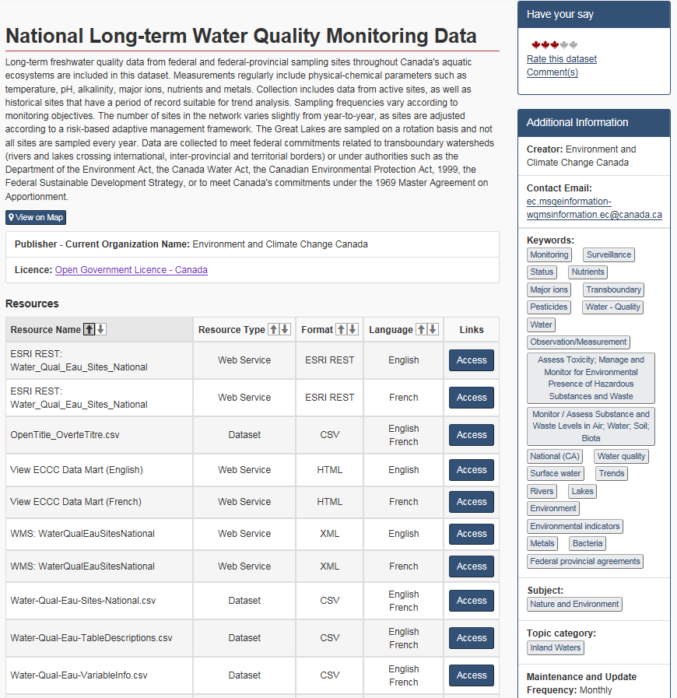
National Water Quality Datasets on Open Data
Standardized format – machine readable e.g. csv format
look-up tables for metadata (site details, variables, method titles)
Level of validation indicated (provisional or validated)
Available in both official languages
Updated within 30 days of receipt of analysis from laboratory
https://open.canada.ca/data/en/dataset/67b44816-9764-4609-ace1-68dc1764e9ea

Slide 11
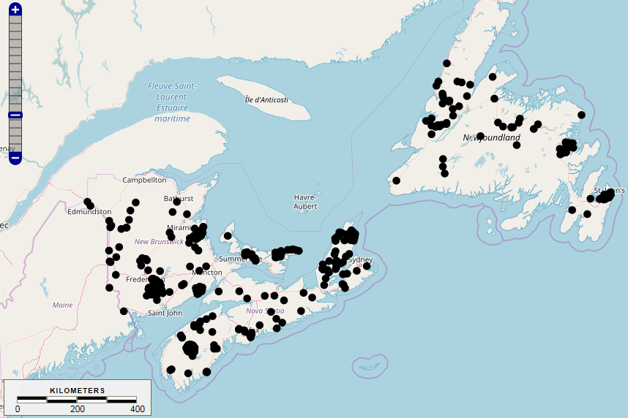
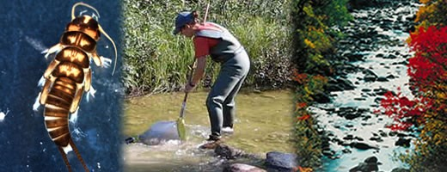
National Water Quality Datasets on Open Data
Online
National Long-term Monitoring
Automated Monitoring
Canadian Aquatic Biomonitoring Network (CABIN)
Freshwater Inventory and Surveillance of Mercury
Many other smaller datasets…
Coming soon
Pesticide Surveillance
Risk-based Assessments

Slide 12
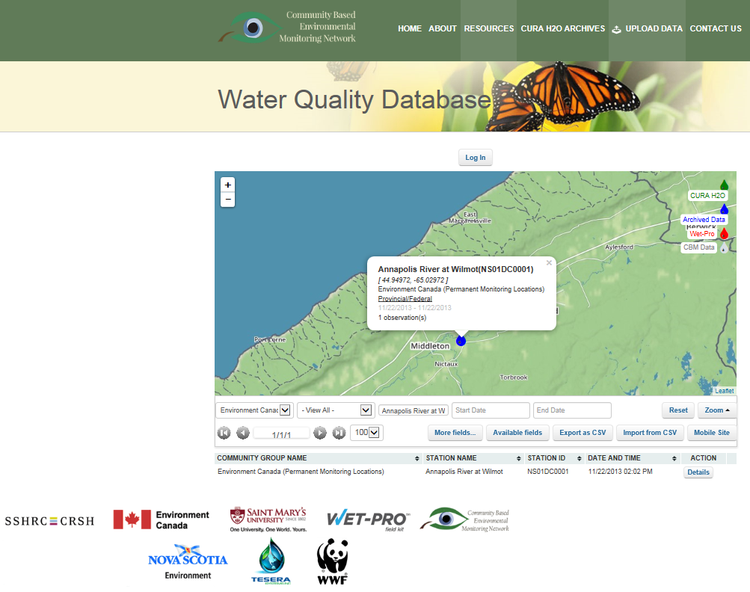
Past collaboration with community-based monitoring on Open Data
Technical advice with the original CURA H2O database, including equipment testing and water sampling certification training
Provided a common platform for data collected by community-based watershed groups in Atlantic

Slide 13
ECCC Funding Support
Four projects with Atlantic Ecosystem Initiative (AEI) funds supporting Atlantic DataStream and Community-Based Environmental Monitoring Network (CBEMN)
Current (Atlantic DataStream Development)
Watershed-Based Monitoring and Database Development for Climate Change Adaptation - Hillsborough River Association (2017-2020)
Past (CURA H2O Database now being migrated into Atlantic DataStream)
Community-Based Water Quality Monitoring throughout the Atlantic Region - CBEMN, c/o Department of Geography, Saint Mary's University (2014-2015)
Community-Based Water Quality Monitoring Expansion Across the Atlantic Region -CBEMN, c/o Department of Geography, Saint Mary's University (2013-2014)
Community-Based Water Quality Monitoring Expansion Across the Atlantic Region - CBEMN, c/o Department of Geography, Saint Mary's University (2012-2013)

Slide 14
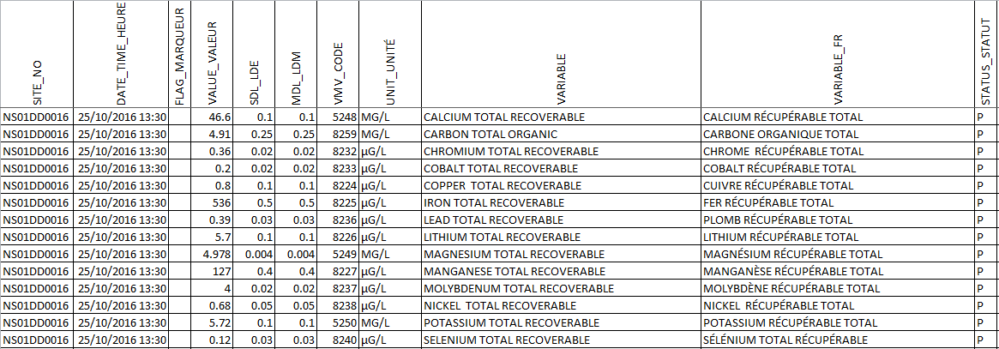
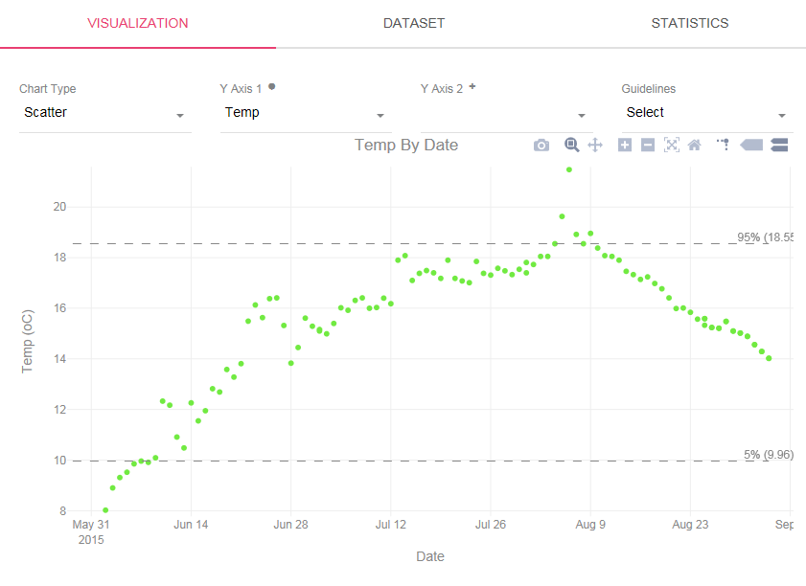
Collaboration with Mackenzie and Atlantic DataStream
In-kind advice on data model to allow long-term ECCC data to be integrated into Mackenzie and Atlantic DataStreams
Commitment to upload ECCC long term data to DataStream hubs (Mackenzie and Atlantic)

Slide 15
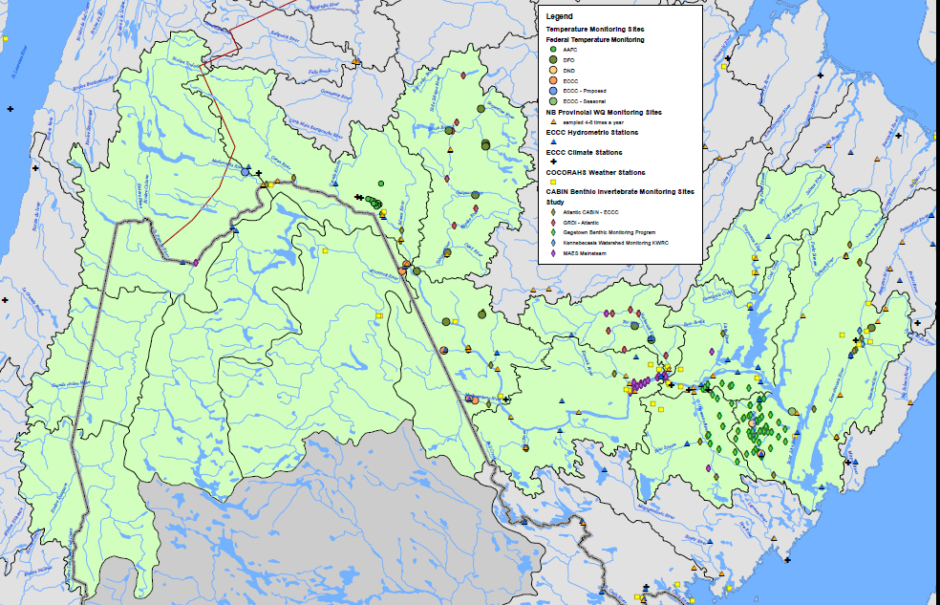
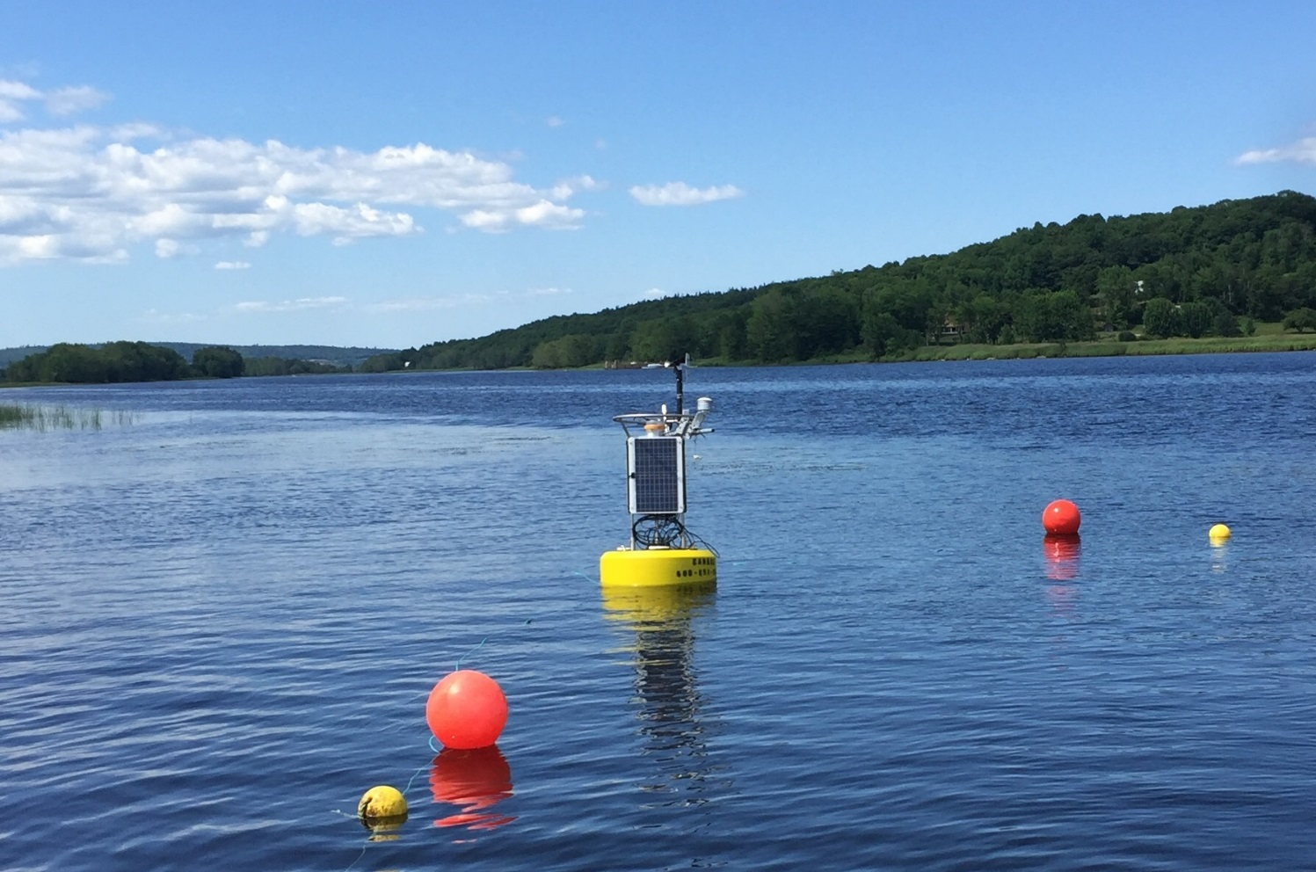
Collaboration with Mackenzie and Atlantic DataStream
Piloting a temperature logger network in partnership with local community groups on the Wolastoq (Saint John) River to fill monitoring gaps
Intend to upload this temperature data to Atlantic DataStream to make data available to all, including federal departments (e.g. Fisheries and Oceans)
ECCC Buoy on Wolastoq (Saint John) River at Evandale

Slide 16
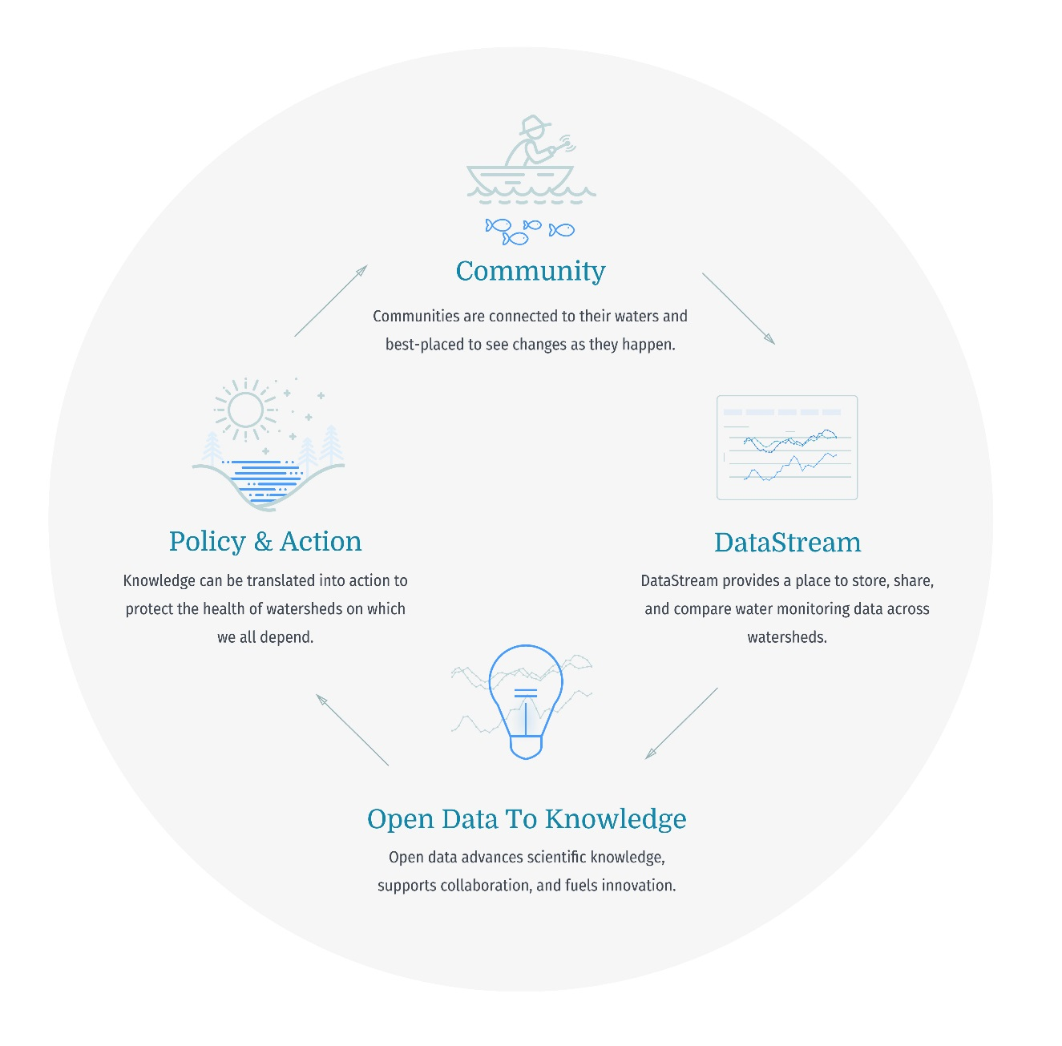
Benefits of DataStream for ECCC
Data consistency – government and community-based information to inform policy and decision making
Accessible and timely data
Access to additional analysis tools for users – value added
Improved data quality
Strengthen linkages between community-based monitoring groups and government
Source: The Gordon Foundation

Slide 17
Thank you!
Any questions?
arash.shahsavarani@canada.ca
Or
denis.parent@canada.ca

Slide 18
Final Thoughts - Advice from others…
To Publish or Not to Publish
The question of whether to publish data to a common data repository or hub often shows up like this:
“Seeking input on water quality database design. Our volunteer data lives in an Excel spreadsheet with a separate file for each lake. We have longed to create a database and are finally in the process of making this happen. Should we also send our data to a national repository?”
A resounding YES! In fact, regardless of what entity you represent, if you are NOT publishing all relevant data to a collective data hub, you are losing resources, leverage, opportunities and impact. This is also true if you are not using all possible available relevant data, in addition to your own, to inform your decision-making activities.
Why publish data? What’s the big deal?
It is time to shift our mindsets from “data for a purpose right now” to “data as an asset,” valuable long beyond its original purpose and used repeatedly for generations
Source: National Water Monitoring News – Spring 2018, National Water Quality Monitoring Council (acwi.gov/monitoring)

