Slide 1
Panel Discussion: The Partnership of DataStream
Emma Wattie, Atlantic Water Network
@AtlWaterNetwork

Slide 2
Context of Community-Based Monitoring in Atlantic Canada
Emma Wattie, Manager
Atlantic DataStream Kick Off June 5th, 2018

Slide 3
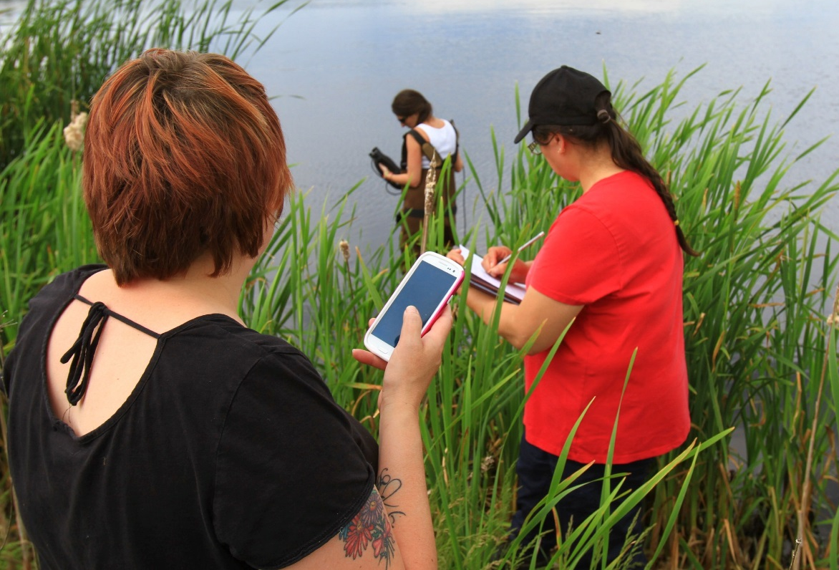
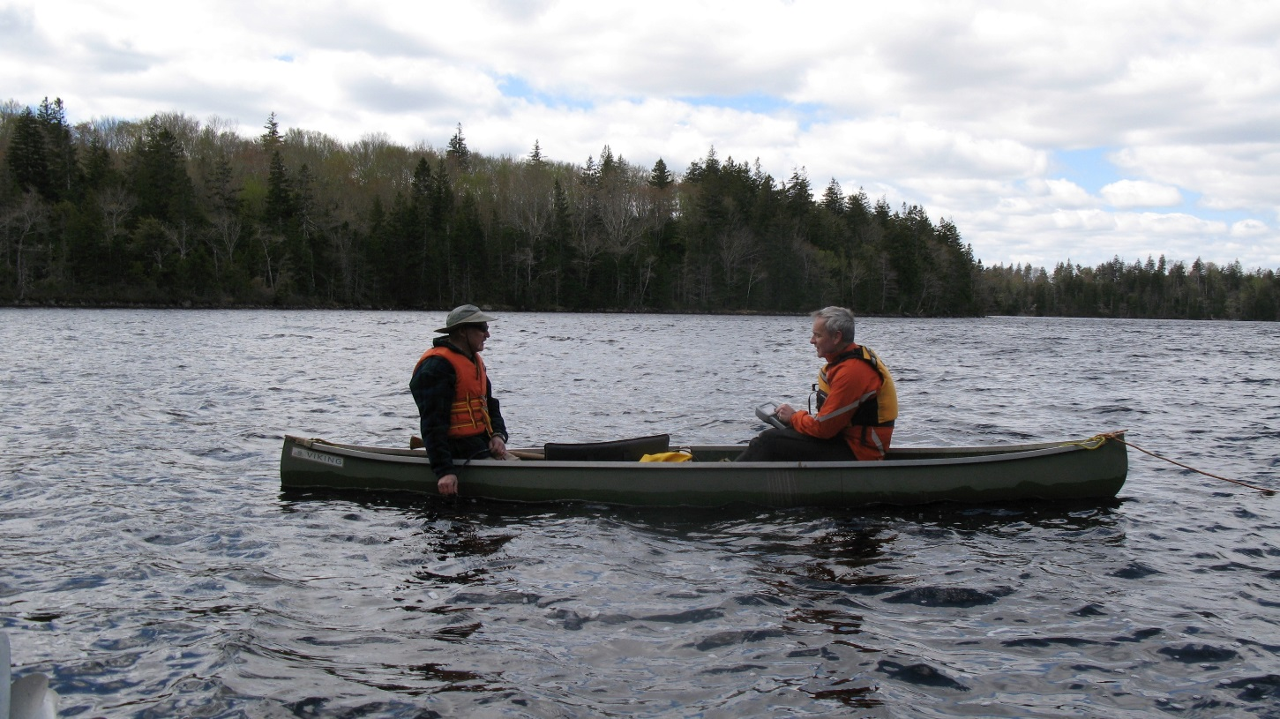
Increase community capacity for environmental monitoring
How?
Provide loans through Environmental Equipment Bank
Facilitate networking among stewardship organizations

Slide 4
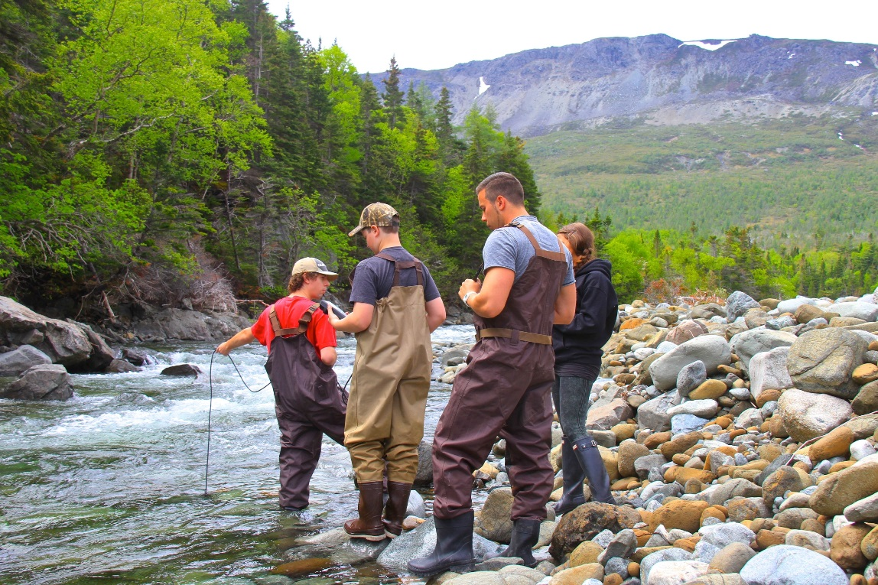
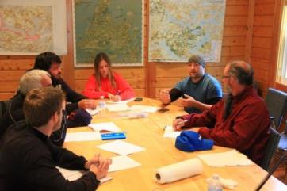
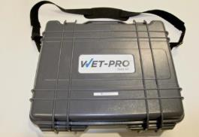
Research project (2011-2016)
Standardization
Training
Equipment
Regional water quality dataset

Slide 5
Water Quality Database
Created in 2012
NOW:
>1,100 locations
>21,000 observations
Data valued >$3.5Million CAD

Slide 6
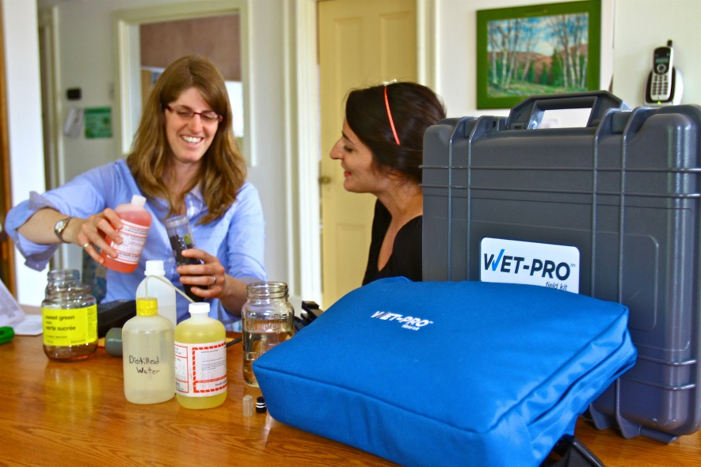
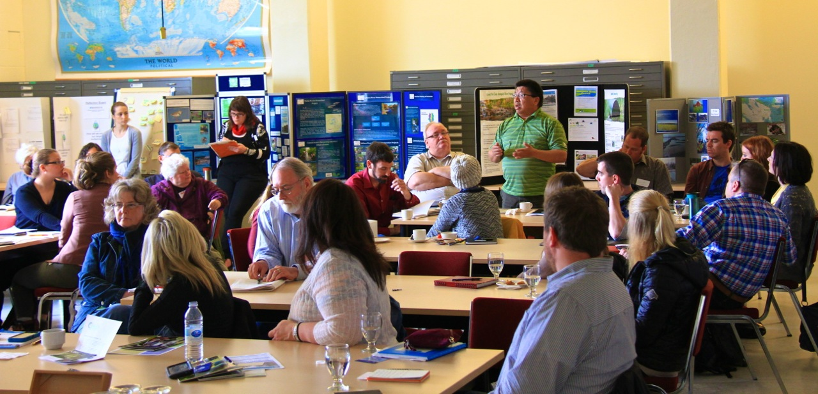
ended… now what?
Started to tackle standardization
Large dataset
Network of community-based water monitors

Slide 7
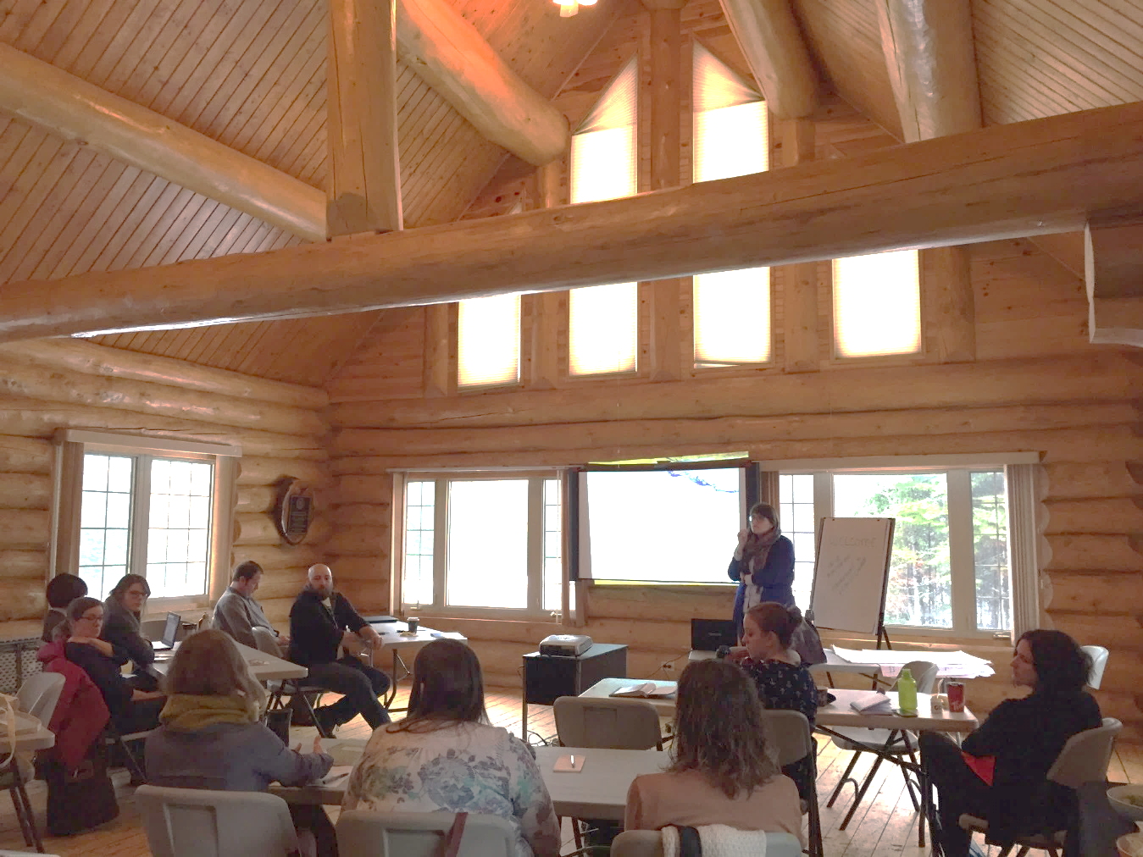
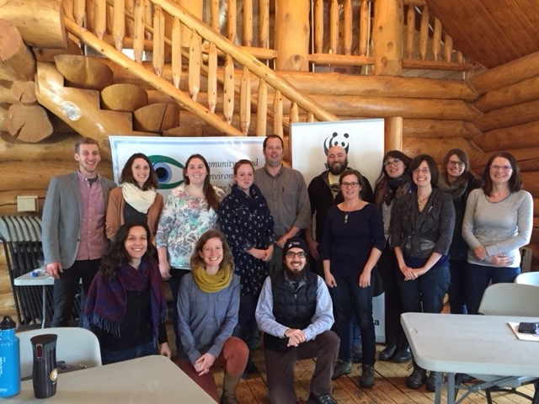
You Spoke…
Notes:
Describe Moncton Workshop
Needs for Data Management
What worked – What didn’t
What about Mackenzie DataStream excited people – Visualizations, ease of upload, several more parameters

Slide 8
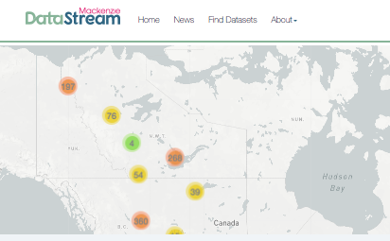
Moncton, New Brunswick - January 2017

Slide 9
We Listened!
Notes:
- First DataStream outside of the Mackenzie River Basin

Slide 10
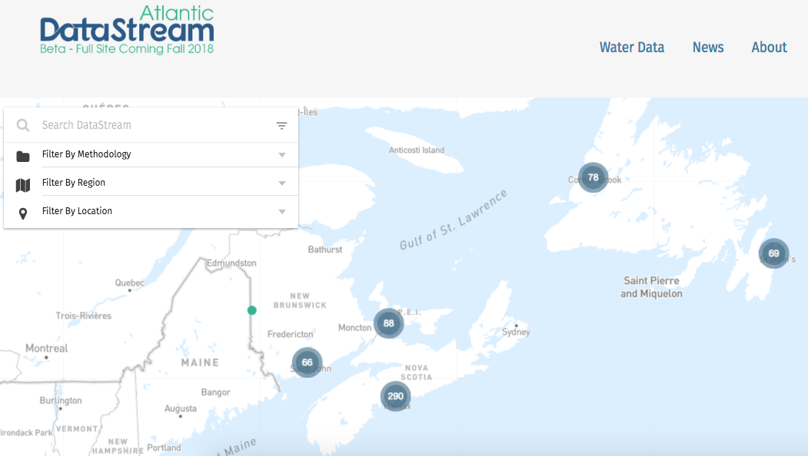
Atlantic Ecosystem Initiative funded project (2018-2020)
CBEMN community partners’ data online!
20 groups online
+ Mi’kmaw Conservation Group & Environment and Climate Change Canada
Successful proposals to bring more datasets online

Slide 11
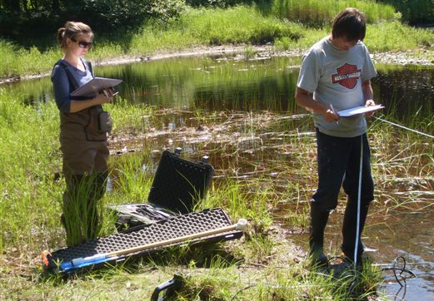
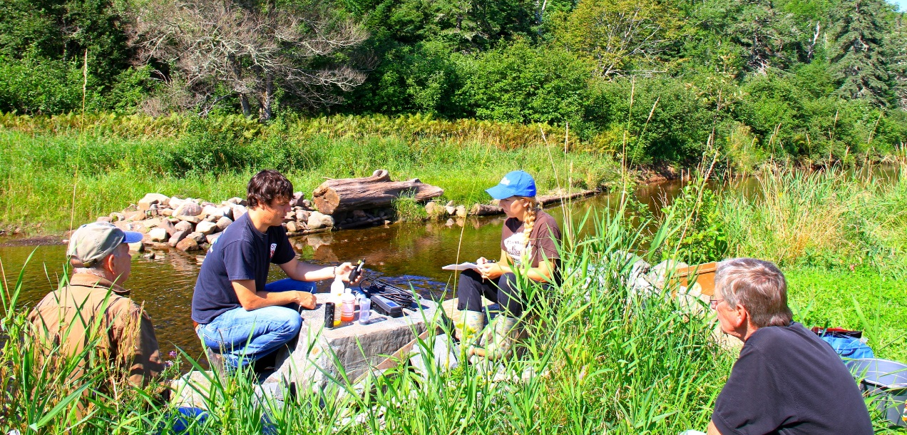
Just the Beginning!
Training opportunities
Summer 2018 – Equipment
Fall 2018 & Winter 2019 – Data
Onboarding new organizations
New equipment in Equipment Bank
MORE!

Slide 12
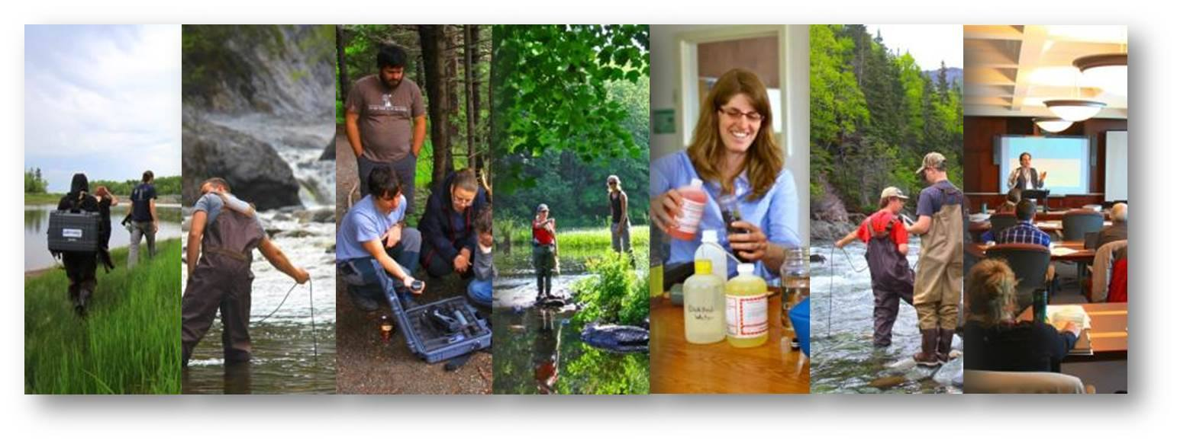
Thank you!
Emma Wattie
emma.wattie@smu.ca
Notes:
The list of Thank you’s is a long one!
-Shout out to Sarah Weston & Oliver Woods & all those involved in CURA H2O
MANY thanks to The Gordon Foundation – DataStream National Leads
WWF Canada & Hillsbourough River Association
Environment & Climate Change Canada
All of You! Without the NUMEROUS community partnerships

